Slide 1
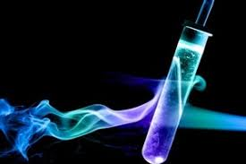
Energy changes in Chemistry

Slide 2

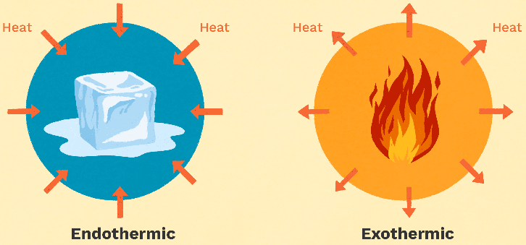
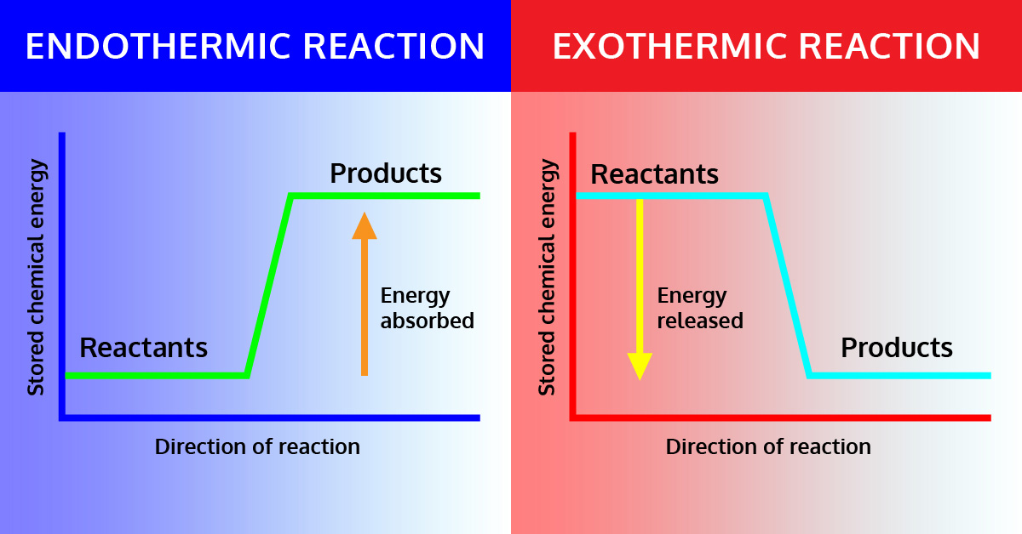
Outline
Part 1:
Chemical energy
Energy conservation
Exothermic and Endothermic Systems
Part 2:
Enthalpy
Energy profile diagrams

Slide 3
Outline: Part 2
Thermochemical equations
Enthalpy
Energy Profile Diagrams
Pearson chapter 10.2

Slide 4
Outline: Part 2
In Part 1 we looked at energy changes in chemical reactions and physical changes
We touched on that chemical reactions involve greater energy change than physical changes.
To be more precise we use thermochemical equations which include a sign and numerical value for the energy change
We also use energy profile diagrams to represent the energy change

Slide 5
Enthalpy
The stored chemical potential energy of a substance is called enthalpy
It is given the symbol H
All chemicals contain stored chemical potential energy or enthalpy. We are interested in the change in enthalpy that occurs in a chemical reaction.
The exchange of heat energy between the system and its surrounds is referred to as enthalpy change, or heat of reaction, and is given the symbol ΔH

Slide 6
Enthalpy
For a chemical reaction:
reactants → products
Calculating enthalpy change (ΔH):
ΔH = H_{products} - H_{reactants}

Slide 7
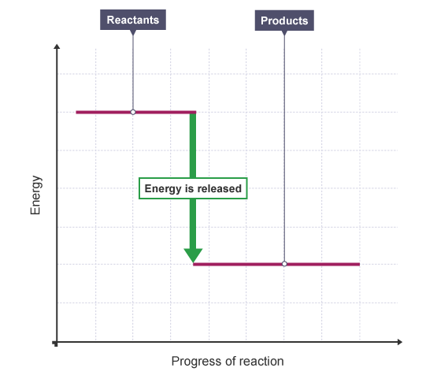
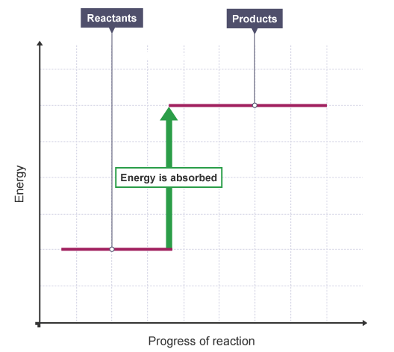
Enthalpy
Exothermic
Endothermic
ΔH = H_{products} - H_{reactants}
ΔH = H_{products} - H_{reactants}
ΔH < 0 (negative)
ΔH > 0 (positive)

Slide 8
Thermochemical equations
A thermochemical equation is a reaction equation that included the ΔH value to show the enthalpy change
We write the ΔH value next to the equation on the right side
Change in enthalpy, ΔH, usually has the units kJ
It can also be in kJ/mol if the question specifies that the energy is in reference to a particular compound.

Slide 9
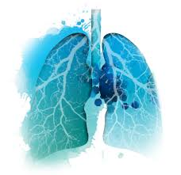
Thermochemical equations
Respiration
C₆H₁₂O₆ _{(aq)} + 6O₂ _{(g)} → 6CO₂ _{(g)} + 6H₂O _{(l)} + energy
Written as a thermochemical equation:
C₆H₁₂O₆ _{(aq)} + 6O₂ _{(g)} → 6CO₂ _{(g)} + 6H₂O _{(l)} ΔH = -2803 kJ
If they specify this is the enthalpy for 1 mole of glucose reacts with 6 moles of oxygen to produce 6 moles of carbon dioxide and 6 moles of water, 2803 kJ of energy is released to the surroundings then it would be in kJ mol⁻¹

Slide 10
Thermochemical equations
Written as a thermochemical equation:
C₆H₁₂O₆ _{(aq)} + 6O₂ _{(g)} → 6CO₂ _{(g)} + 6H₂O _{(l)} ΔH = -2803 kJ
We can also include the energy value as part of the equation:
C₆H₁₂O₆ _{(aq)} + 6O₂ _{(g)} → 6CO₂ _{(g)} + 6H₂O _{(l)} + 2803 kJ
* The ΔH is still negative *

Slide 11
Thermochemical equations
It is useful to be able to compare the amount of enthalpy change between different reactions. We can only do this if each reaction is for the same amount of the reactant of interest.
Example - combustion of hydrogen gas
2H₂ _{(g)} + O₂ _{(g)} → 2H₂O _{(l)} ΔH = -572 kJ
we want to know the energy per 1 mol of hydrogen gas, so we divide the whole equation by 2, this includes dividing ΔH by 2.
H₂ _{(g)} + ½ O₂ _{(g)} → H₂O _{(l)} ΔH = -286 kJ

Slide 12
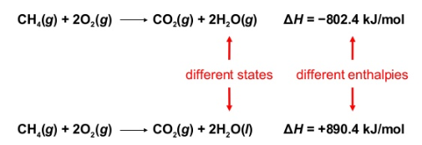
Thermochemical equations
Always specify the physical states of reactants and products because they help determine the actual enthalpy changes
Recall – changes of phase also involve an energy change

Slide 13
Thermochemical equations
The effect of reversing a chemical equation
The magnitude of ΔH stays the same but the sign changes. This demonstrates the law of conservation of energy

Slide 14
Energy profile diagrams
H_{reactants}
CH_{4(g)} + 2O_{2(g)}
From this Energy profile diagram you should be able to write the chemical equation with energy included and the thermochemical equation.
Try for yourself
enthalpy
ΔH = -890.3 kJ
CO_{2(g)} + 2H₂O_{(l)}
H_{products}
Progress of reaction
Axis labels: Y-axis is enthalpy, H
X-axis is progress of reaction (NEVER USE TIME)
Draw line reactants and products – above each write the actual chemicals

Slide 15
Energy profile diagrams
H_{reactants}
CH_{4(g)} + 2O_{2(g)}
enthalpy
ΔH = -890.3 kJ mol⁻¹
CO_{2(g)} + 2H₂O_{(l)}
H_{products}
Progress of reaction
CH_{4(g)} + 2O_{2(g)}
CO_{2(g)} + 2H₂O_{(l)} + 890.3 kJ
CH_{4(g)} + 2O_{2(g)}
CO_{2(g)} + 2H₂O_{(l)} ΔH = -890.3 kJ

Slide 16
Energy profile diagrams
Draw an energy profile diagram for the following reactions. Remember your first question should be – is this reaction exothermic or endothermic?
1.
2.

Slide 17
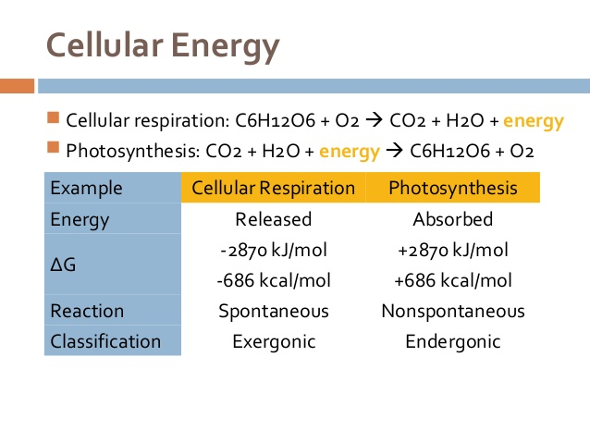
Energy for you

Slide 18
Question
Respiration can be represented by the following reaction
C₆H₁₂O₆ _{(aq)} + 6O₂ _{(g)} → 6CO₂ _{(g)} + 6H₂O _{(l)} ΔH = -2803 kJ
How much energy is released in the conversion 1 mole of glucose into carbon dioxide and water?
How much energy is released in the production 1 mole of carbon dioxide?
How much energy is released when 50 g of glucose is converted into carbon dioxide and water?
What mass of oxygen is produced when 1540.0 kJ of energy is released?

Slide 19
Answers
C₆H₁₂O₆ _{(aq)} + 6O₂ _{(g)} → 6CO₂ _{(g)} + 6H₂O _{(l)} ΔH = -2803 kj
How much energy is released in the conversion 1 mole of glucose into carbon dioxide and water?
How much energy is released in the production 1 mole of carbon dioxide?
Skill – interpreting thermochemical equations
1 mole of glucose (it already has a coefficient of 1) produces 6 moles of carbon dioxide and 6 moles of water, releasing 2803 kJ of energy
Skill – interpreting thermochemical equations
Production of 6 moles of carbon dioxide releases 2803 kJ of energy
So the production of 1 mole, need to divide equation by 6
Energy = 2803 / 6 = 467.2 kJ

Slide 20
Answers
C₆H₁₂O₆ _{(aq)} + 6O₂ _{(g)} → 6CO₂ _{(g)} + 6H₂O _{(l)} ΔH = -2803 kj
How much energy is released when 50 g of glucose is converted into carbon dioxide and water?
Skill: thermochemical equation interpretation and stoichiometry
Find moles of glucose: n(glucose) = m/M = 50 / 300.07 = 0.167 mol
Use a ratio from the equation: 1 mole glucose = 2803 kJ
0.167 mole glucose = X kJ
Solve for x energy released = 0.167/1 x 2803 = 468.1 kJ

Slide 21
Answers
C₆H₁₂O₆ _{(aq)} + 6O₂ _{(g)} → 6CO₂ _{(g)} + 6H₂O _{(l)} ΔH = -2803 kj
d) What mass of oxygen is produced when 1540.0 kJ of energy is released?
Skill: thermochemical equation interpretation and stoichiometry
Find moles of oxygen required for this amount of energy
6 moles oxygen gas = 2803 kJ
x moles oxygen gas = 1540 kJ
Solve for x = 1540 / 2803 x 6 = 3.296 moles
Use Molar mass to find mass oxygen required.

Slide 22
On going work
Pearson ch 10.2 and chapter 10 review
STAWA
Set 38: energy changes

